Slide 1
CS 6375 Final Project Emotion Detection Using Multilabel Classification with PEFT and Efficient Model Adaptation
Jyothsna Reddy C J – JXC220075
Yasaswi I G S – GXI230000

Slide 2
Introduction
Emotion detection in tweets is vital for applications like mental health monitoring, public sentiment analysis, and customer engagement. However, overlapping emotions and short-text ambiguity pose challenges for multi-label classification. While traditional models like feed forward neural networks struggle with scalability, transformer models like DistilBERT and RoBERTa, though accurate, are resource-intensive. This study addresses these issues by applying Parameter-Efficient Fine-Tuning techniques like LoRA, IA3 and QLoRA to balance accuracy and efficiency, enabling scalable and practical solutions for real-world applications.

Slide 3
Problem Definition
Traditional neural networks struggle with computational efficiency and scalability, making them impractical for large-scale datasets and real-world multi-label emotion classification. Transformer-based models (e.g., DistilBERT, RoBERTa, FLAN T5) provide superior performance by capturing nuanced contextual relationships. High computational and memory requirements of transformers limit their applicability in resource-constrained environments, such as real-time sentiment monitoring or mobile platforms. Balancing accuracy and computational efficiency remains a critical challenge for deploying these models in practical scenarios.

Slide 4
Background – Key concepts
Multilabel Classification:Emotion detection requires handling multiple emotions in a single text (e.g., joy, anger), posing scalability & efficiency challenges for traditional models like LSTMs.
2. Advancements: Transformers Models (DistilBERT, RoBERTa) improve accuracy with rich context.
3. PEFT Techniques: LoRA , IA3 reduces fine-tuning costs; QLoRA adds quantization for efficiency.

Slide 5
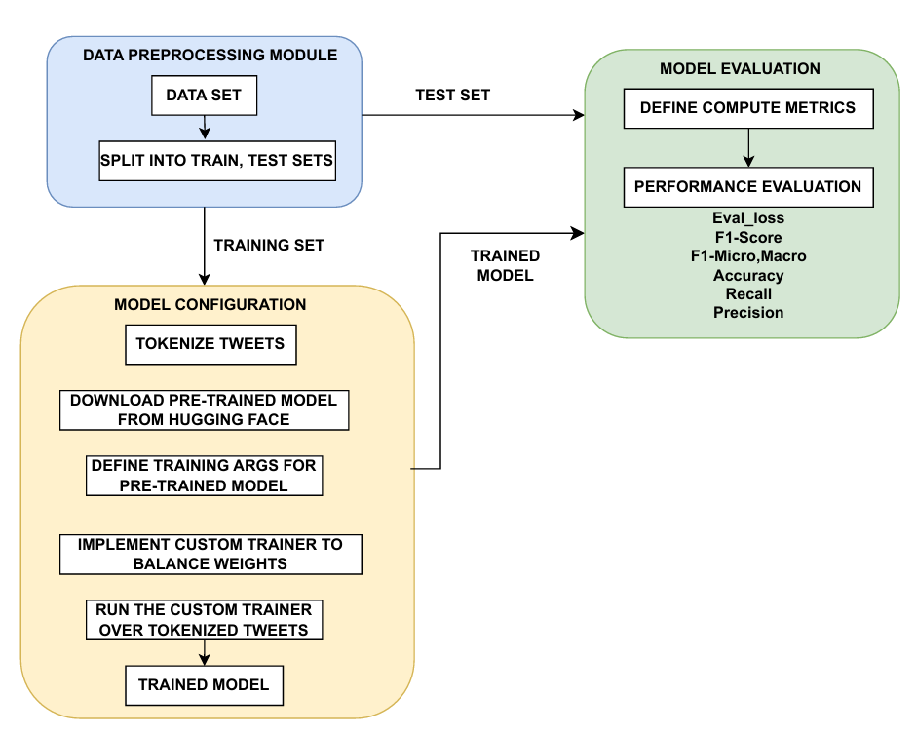
Implementation

Slide 6
Framework (Basic Models)
BERT-base-uncased :
Architecture: BERT-base-uncased was chosen for its robust performance on text classification tasks, leveraging its 12-layer transformer-based architecture with 110M parameters.
Distilroberta :
Architecture: DistilRoBERTa, a distilled version of RoBERTa, was chosen for its lightweight design(82 million parameters) and faster inference while retaining 97% of RoBERTa’s performance.
Flan-T5 :
Architecture: T5(220 million parameters) was selected to explore the potential of a transformer-based model specifically designed for sequence classification.

Slide 7
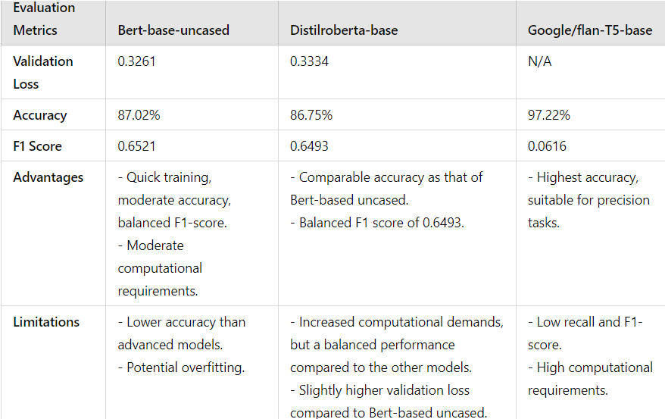
Results

Slide 8
Observations
Accuracy: T5 shows superior accuracy, but the extremely high precision(99.83%) indicates potential class imbalance or overfitting.
F1 Score: DistilBERT and RoBERTa have balanced F1 scores(~0.65-~0.64), suggesting a better balance between precision and recall than T5.
Recall: T5's low recall(6.25%) indicates that it might be missing out on predicting some classes correctly.

Slide 9
Framework(Adv Models)
Google/GEMMA-1.1-2b: It is a transformer-based model pre-trained on a large corpus of text data to perform sentiment analysis.
Alibaba-NLP/gte-QWEN1.5-7b: It is also a transformer-based model, but it is specifically designed for instruction-following tasks, making it potentially well-suited for emotion detection.
While these models are powerful, their high computational requirements and memory overhead can limit their applicability in general system environments.
To address these challenges, we employ Parameter-Efficient Fine-Tuning (PEFT) techniques. PEFT enables us to fine-tune only a small subset of the model’s parameters (e.g., adapters like LoRA, IA3, or QLoRA), significantly reducing the computational overhead and memory usage without compromising accuracy

Slide 10
Framework(PEFT)
LORA (Low-Rank Adaptation): Freezes original weights; updates trainable low-rank matrices, Updates modeled as Wi×Xi.
IA3 (Input Scaling): Keeps weight matrices unchanged. Optimizes via input activation scaling.
QLoRA (Quantized Low-Rank Adaptation): Combines LoRA with 4-bit parameter quantization (instead of 16/32 bits). Enables memory-efficient fine-tuning with minimal resource usage.

Slide 11
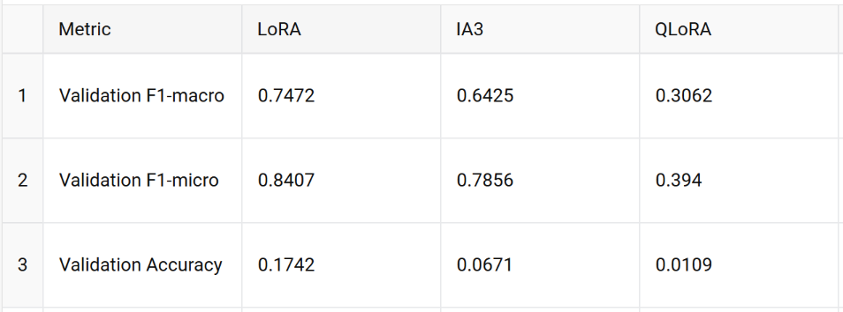
Results

Slide 12
Observations
LoRA demonstrated the highest performance across all metrics, with a validation F1-macro score of 0.7472, F1-micro score of 0.8407, and accuracy of 0.1742.
IA3 achieved moderate performance, with an F1-macro score of 0.6425, F1-micro score of 0.7856, and accuracy of 0.0671.
QLoRA showed the lowest performance, with an F1-macro score of 0.3062, F1-micro score of 0.3940, and accuracy of 0.0109, likely due to the larger base model used (Qwen-7billion parameters).

Slide 13
Challenges Encountered
Limited Computing Power: High computational demands, especially from models like T5 and gte_qwen_1.5, restricted the ability to train on the entire dataset.
Data Size: Computational constraints limited the use of the full dataset, reducing training effectiveness.
Model Complexity: Advanced architectures like RoBERTa, T5, and gte_qwen_1.5 required significant tuning and prolonged training times, increasing computational costs.

Slide 14
Conclusion
Model Recommendations: The choice of model depends on task-specific requirements, balancing performance, scalability, and cost.
BERT-base-uncased: Best for quick prototyping in resource-constrained setups.
DistilRoBERTa-base: Balanced efficiency and accuracy for moderate tasks.
Google/Flan-T5-base: Exceptional accuracy but highly computationally intensive.
PEFT:
LoRA and IA3 excel in parameter-efficient fine-tuning, with LoRA achieving top performance on the google/gemma-1.1-2b-it model.
QLoRA shows potential but requires optimization for larger models like Alibaba-NLP/gte-Qwen1.5-7B-instruct.

Slide 15
Future Work
Explore newer and advanced transformer models, including instruction-tuned models.
Develop techniques to reduce computational needs, such as better quantization and sparsity methods.
"We are planning to deploy our pre-trained model to WandB to facilitate inference for similar sentiment analysis tasks on large models in related contexts."
Focus on more efficient fine-tuning approaches to save resources.
Make emotion detection tools more scalable and accessible for various applications.

